Slide 1
DATA ANALYTICS SQL- MINI PROJECT

Slide 2
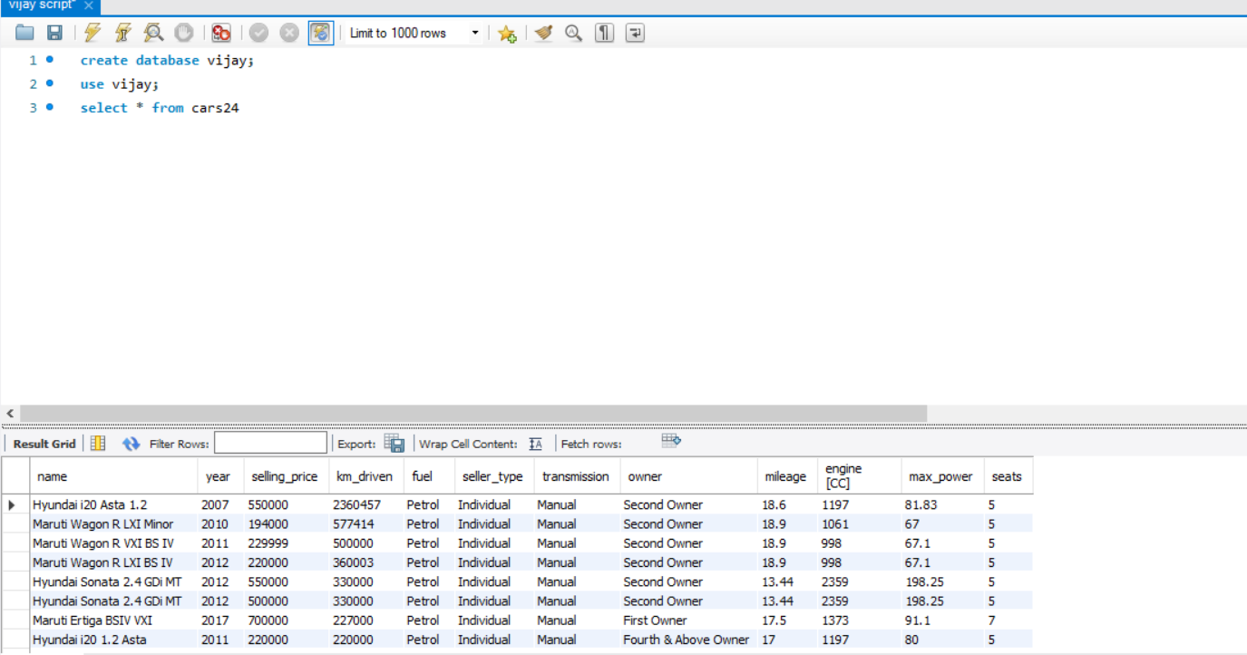
INSIGHT NO 1 To read the whole table. select * from cars24;

Slide 3
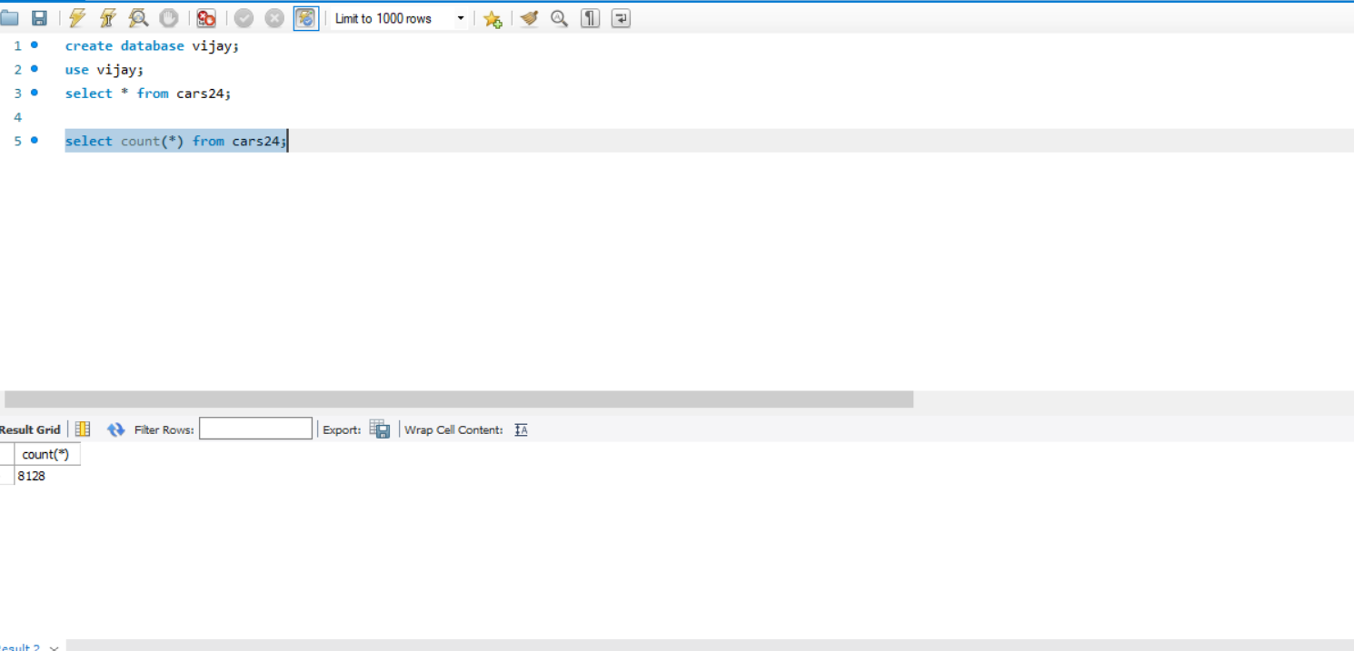
INSIGHT NO 2 To count all from table. select count(*) from cars24;

Slide 4
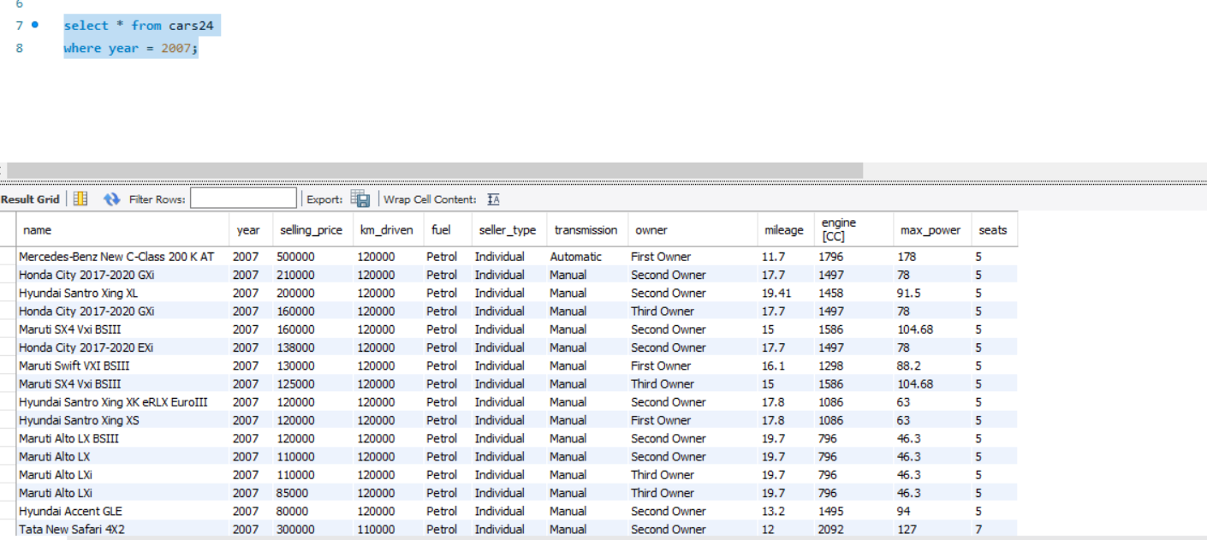
INSIGHT NO 3 To find the all details of the car in the year 2007. select * from cars24 where year = 2007;

Slide 5
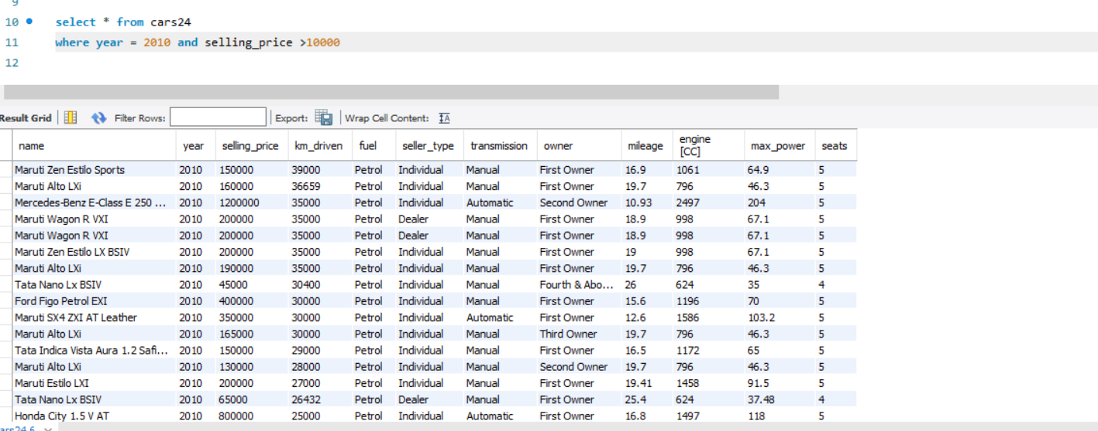
INSIGHT NO 4 To find the all details of the table in the year 2010 and selling price greater than 10000. select * from cars24 where year = 2010 and selling_price >10000;

Slide 6
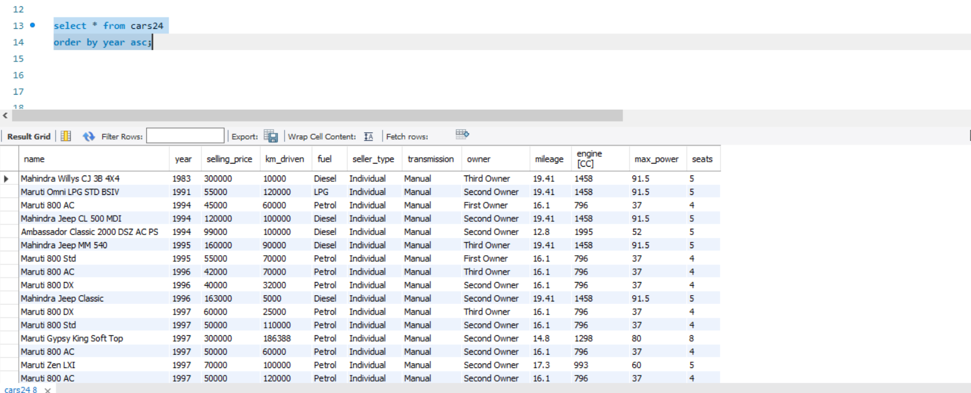
INSIGHT NO 5 To find the all details of the table and order them in ascending order of the year. select * from cars24 order by year asc;

Slide 7
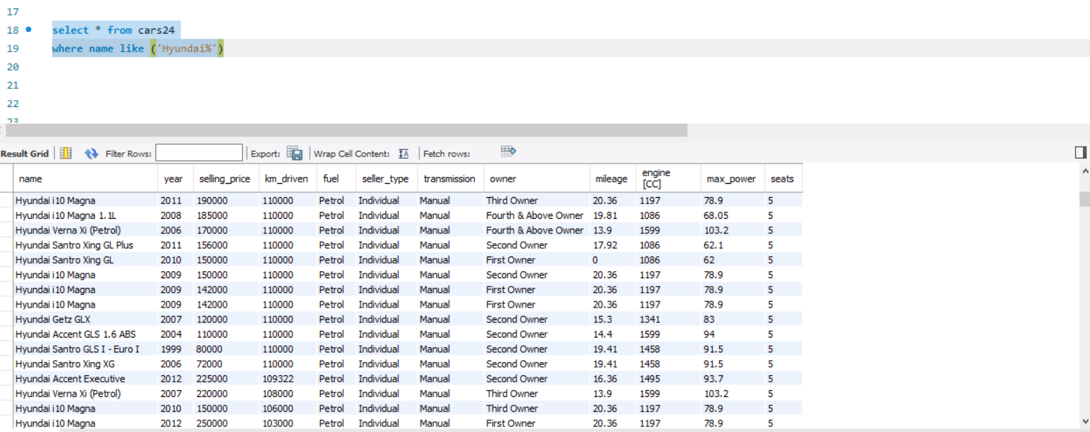
INSIGHT NO 6 To find the details of the table that starts with the name Hyundai. select * from cars24 where name like ('Hyundai%');

Slide 8
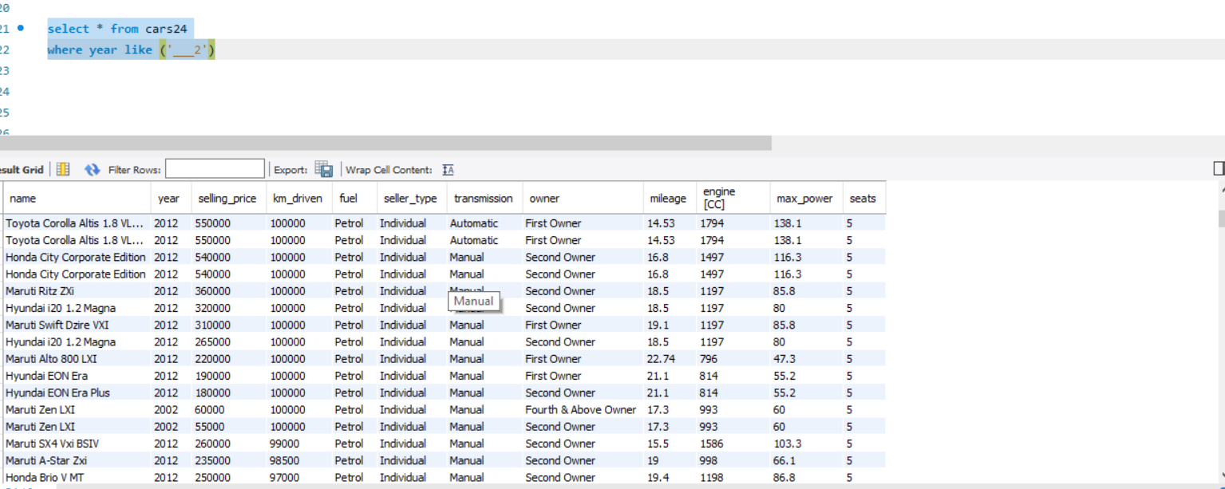
INSIGHT NO 7 To find the details of the table where the year ends with number 2. select * from cars24 where year like ('___2');

Slide 9
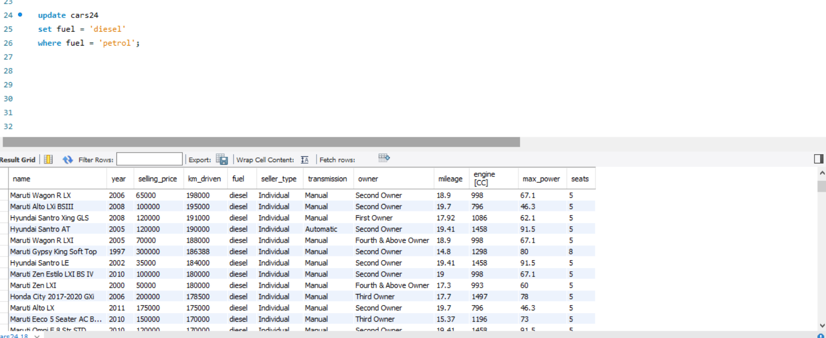
INSIGHT NO 8 To update the details of the table by changing diesel in the place of Petrol. update cars24 set fuel = 'diesel' where fuel = 'petrol';

Slide 10
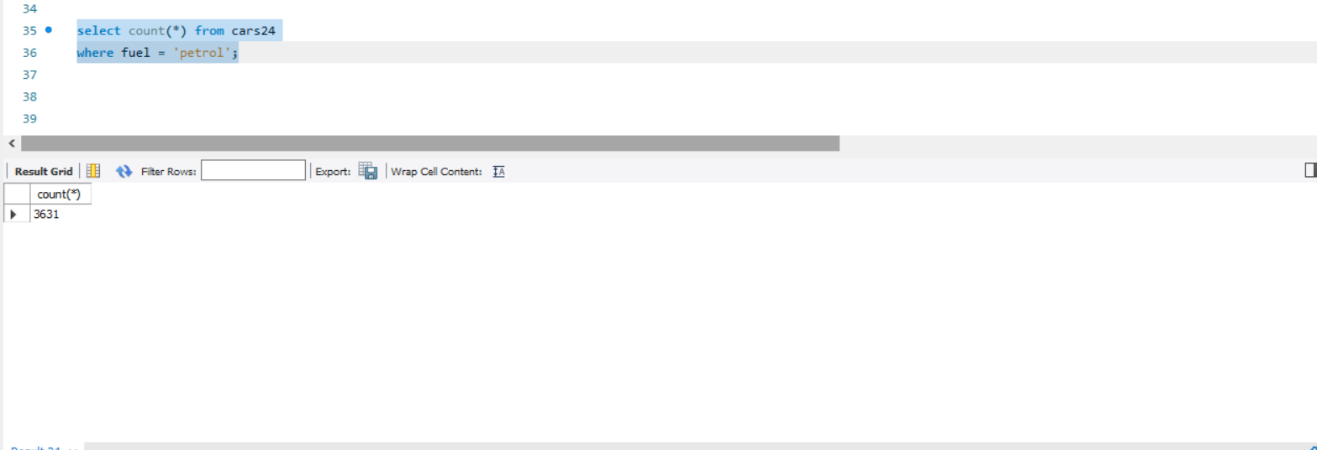
INSIGHT NO 9 To count the total no of petrol using cars from the table. select count(*) from cars24 where fuel = 'petrol';

Slide 11
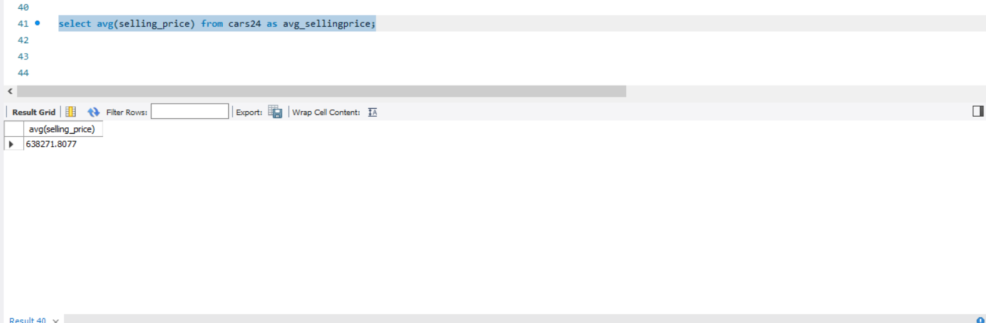
INSIGHT NO 10 To find the average selling price. Select avg(selling_price) from cars24 as avg_sellingprice;

Slide 12
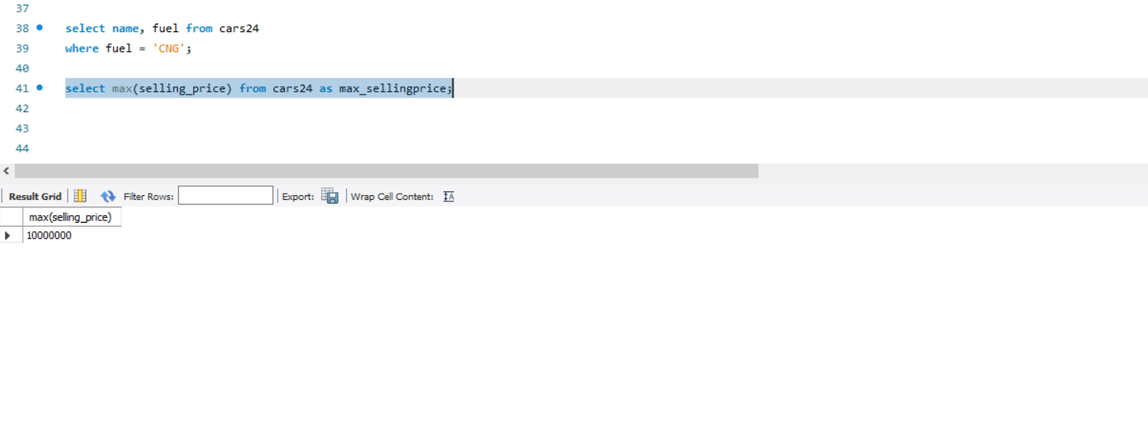
INSIGHT NO 11 To find the maximum selling price. Select max(selling_price) from cars24 as max_sellingprice;

Slide 13
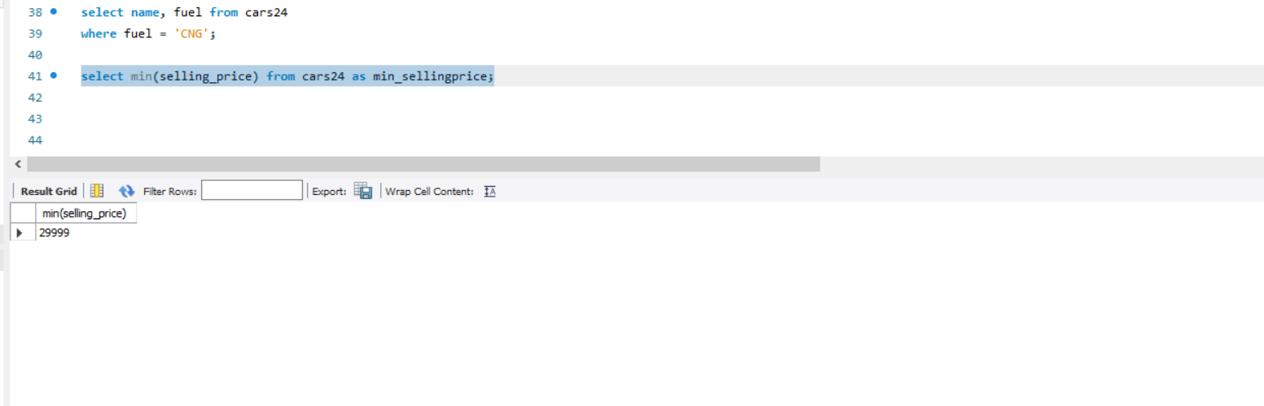
INSIGHT NO 12 To find the minimum selling price. Select min(selling_price) from cars24 as min_sellingprice;

Slide 14
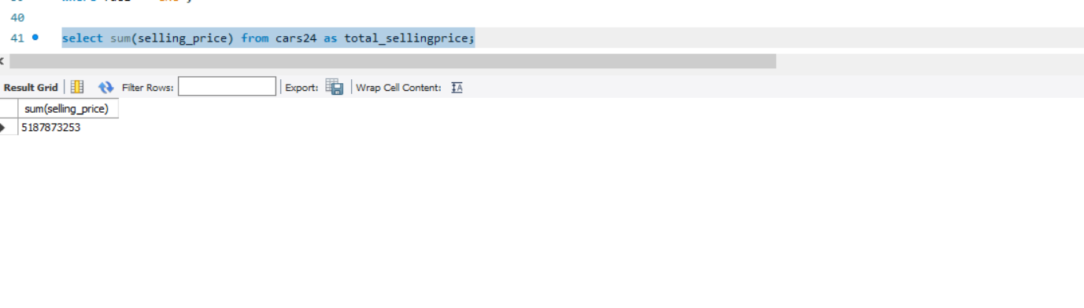
INSIGHT NO 13 To find the total selling price. Select sum(selling_price) from cars24 as total_sellingprice;

Slide 15
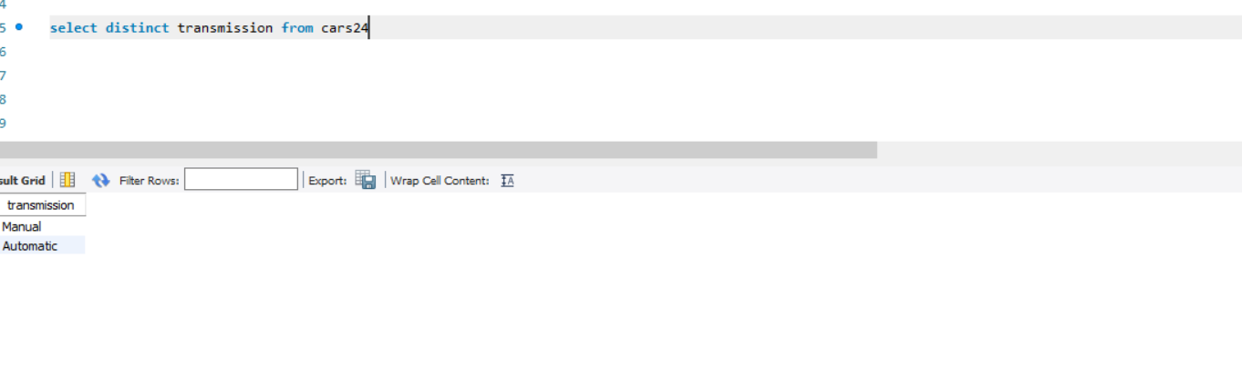
INSIGHT NO 14 To find the unique type of transmission. select distinct transmission from cars24;

Slide 16
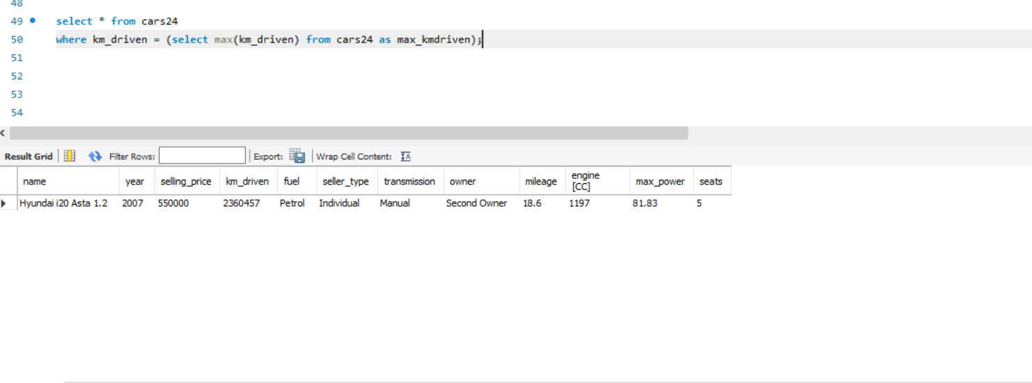
INSIGHT NO 15 To find the max kilometer driven. select max(km_driven) from cars24 as max_kmdriven; select * from cars24 where km_driven = (select max(km_driven) from cars24 as max_kmdriven);

Slide 17
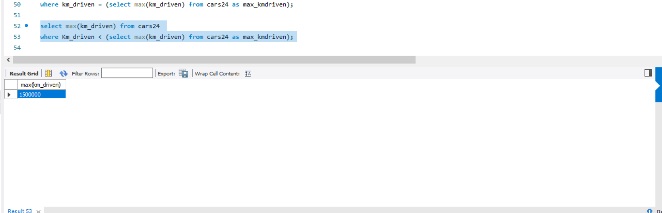
INSIGHT NO 16 To find the next max kilometer driven. select max(km_driven) from cars24 where Km_driven < (select max(km_driven) from cars24 as max_kmdriven);

Slide 18
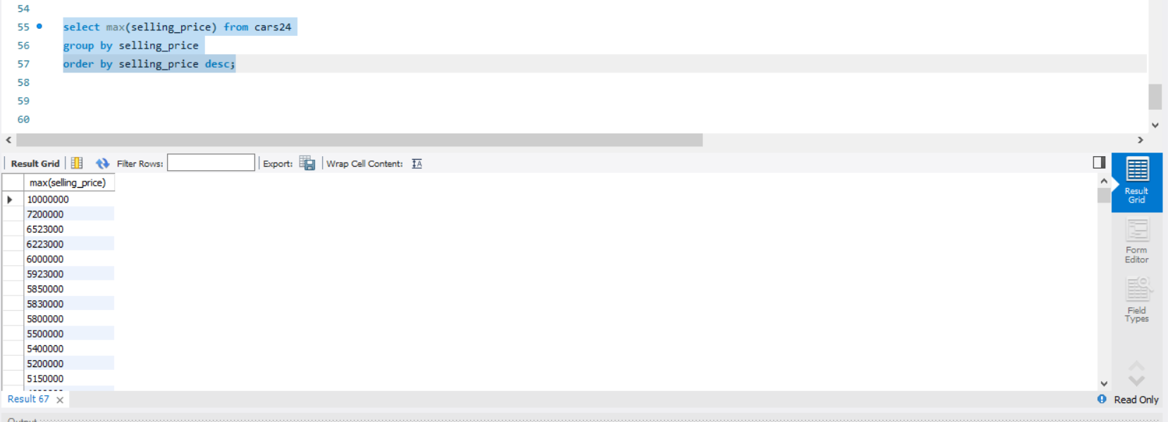
INSIGHT NO 17 To find the max selling price , group by selling price , order by descending. select max(selling_price) from cars24 group by selling_price order by selling_price desc;

Slide 19
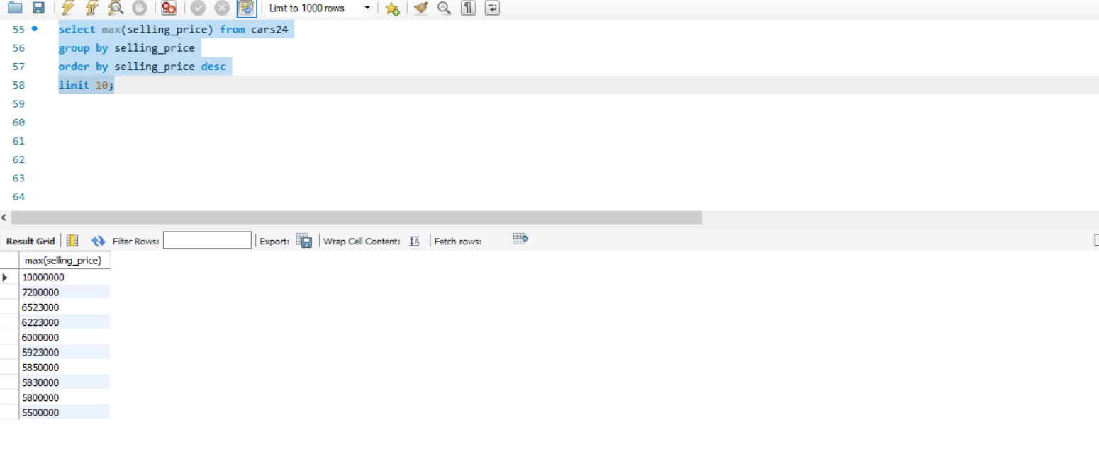
INSIGHT NO 18 To find the first 10 max selling price , group by selling price , order by descending.. select max(selling_price) from cars24 group by selling_price order by selling_price desc limit 10;

